Slide 1
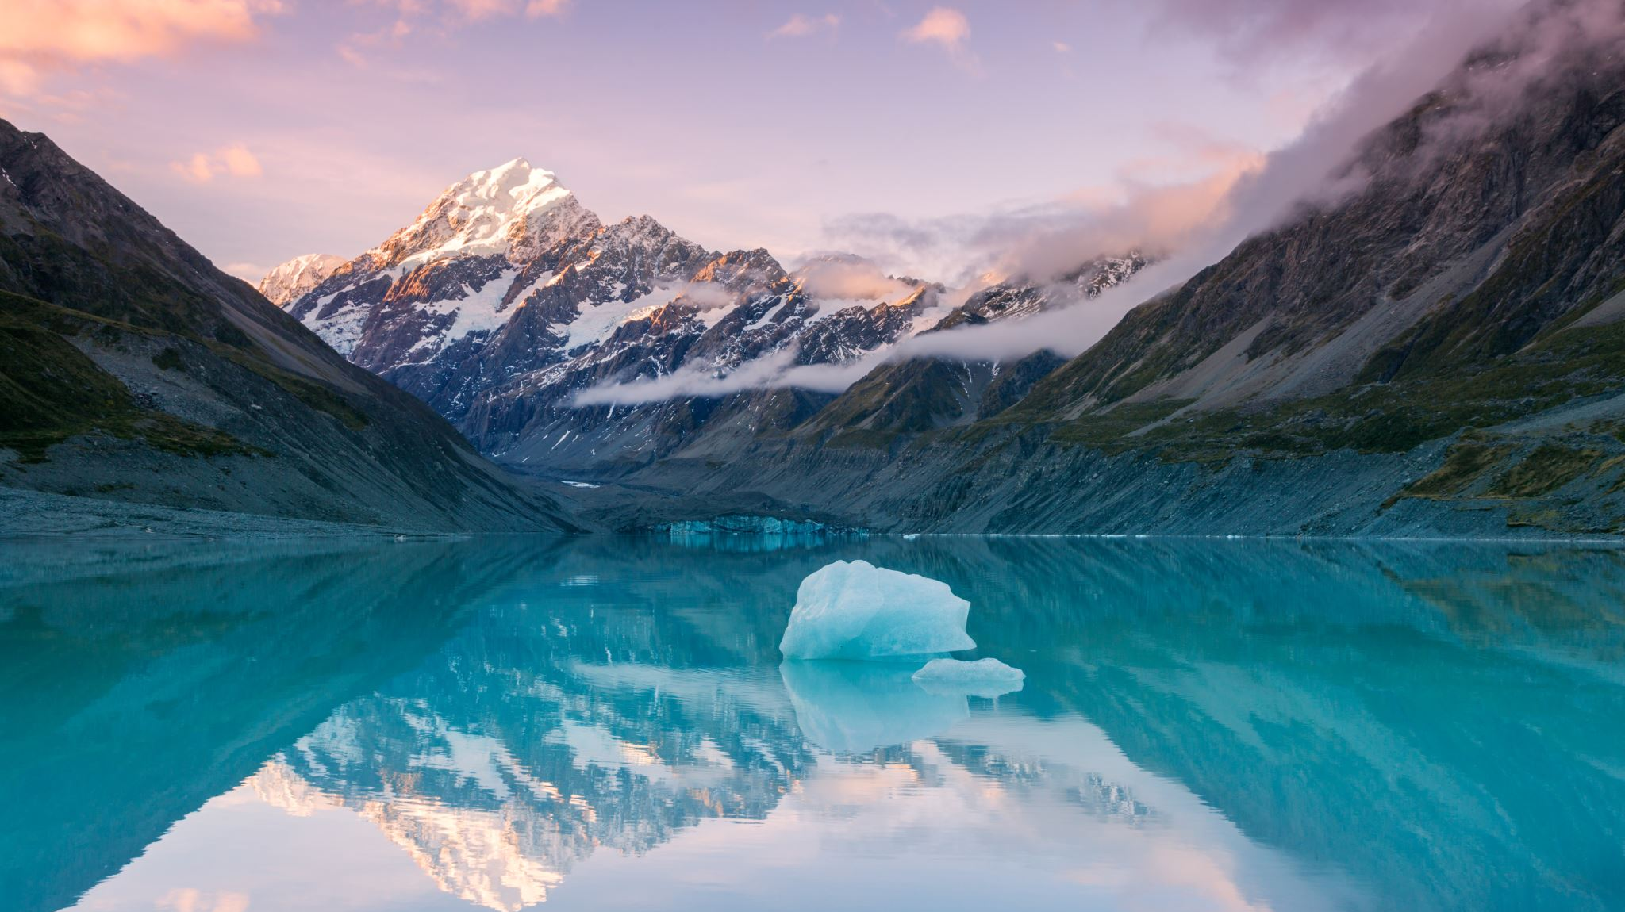
Mystery at the wildlife preserve: Multispectral imagery
Dillon Dugan

Slide 2

Mystery at the Wildlife Preserve
Decrease in Rose-Crested Blue Pipit nesting pairs at Lekagul Preserve
Significant enough to cause concerns for populations
Wildlife tech wants imagery analysis to determine cause
National Space Service provided multi-spectral imagery of the preserve for analysis
6 bands channels ordered by wavelength
Blue visible, Green visible, Red visible, Near-infrared, Short-Wave Infrared 1 and 2
TIF files are in 8-bit with 651 rows and columns
Observations occur from March 2014 to December 2016
12 images over the course of nearly 3 years
Note: images are not equally spaced in time

Slide 3
Goals of Multispectral Imagery Analysis
Goal 1: How much area is covered by a pixel in these images
Boonsong Lake on the preserve is 3000 ft from north to south
Using Boonsong Lake image, analyze and report scale of supplied satellite data
Goal 2: Confidently identify some features from the images
Use of true color (Red-Green-Blue channels to have visible satellite imagery
Goal 3: Identify features of the imagery that need additional information/can’t be explained by imagery data alone
Interested in changes over time that might be the causation of Pipit nesting decline
Steer away from easily explained phenomena like cloud cover
Features from imagery must be confidently identified

Slide 4
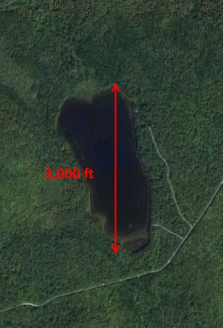
Goal 1
For this goal, Boonsong Lake was identified from the satellite imagery
Once the lake is identified, convert to HSV (Hue, Saturation, Value) to apply masking
Then a blue mask applied to obtain the lake pixels
A rectangle was contoured around the lake to determine its pixel dimensions
As known from the boonsong_lake.jpg, the lake is 3,000 feet long
Dividing 3,000 by pixel height will give feet per pixel
Squaring this number will give square feet per pixel (Area per pixel)

Slide 5
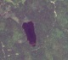
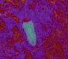
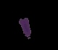
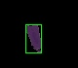
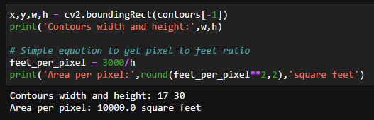
Goal 1
From left to right, is the process of determine pixel length of the lake
Each pixel covered 10,000 square feet
Entire satellite image covers 651x651 pixels x 10,000 sq ft/pixel = 4,238,010,000 sq ft
Approximately, 97,300 acres

Slide 6

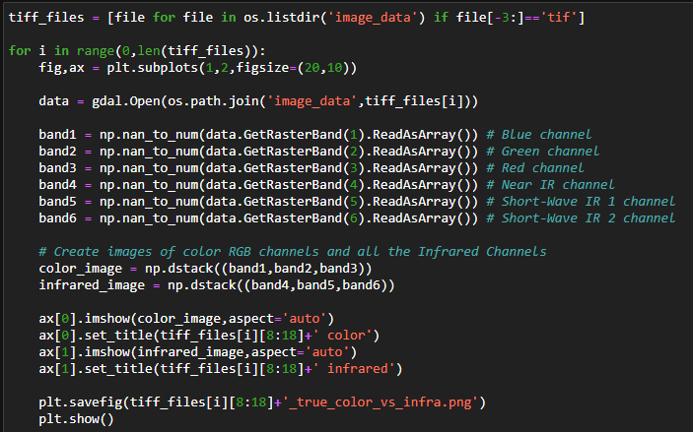
Goal 2
For this goal, true color RGB imagery as well as the IR channels were stacked to look for visual features that stand out
The first three channels provided RGB images while the last three provided infrared images
Loop over all 12 tif files provided from dataset

Slide 7
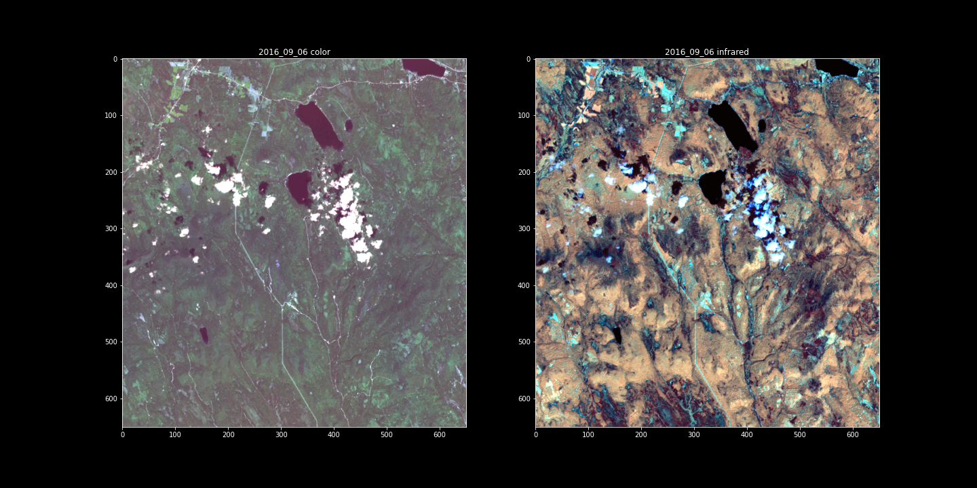
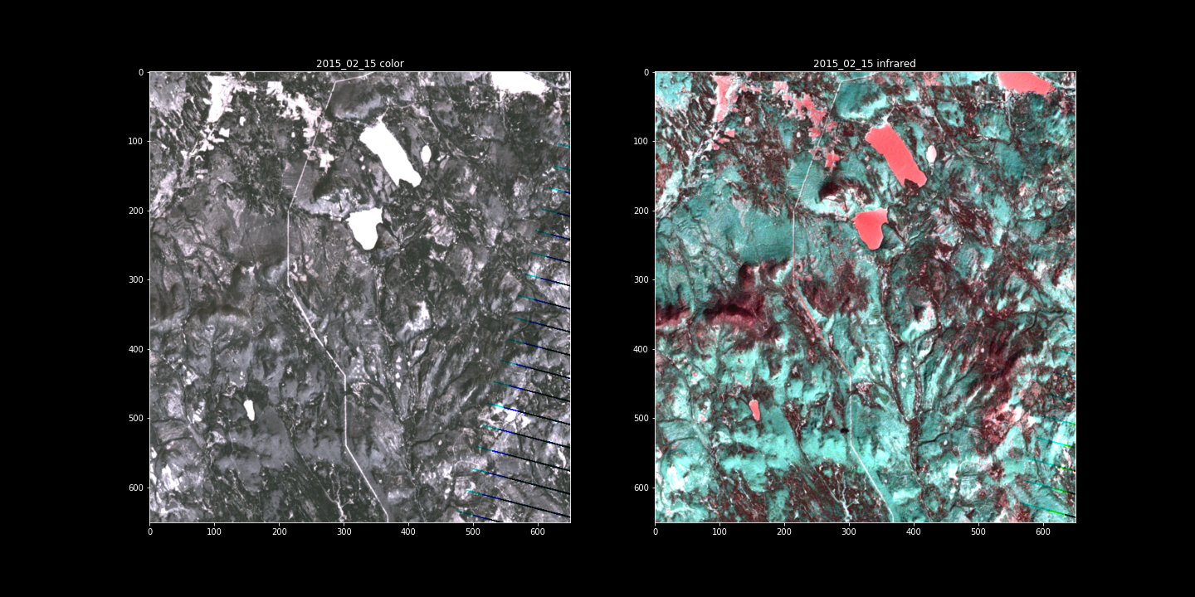
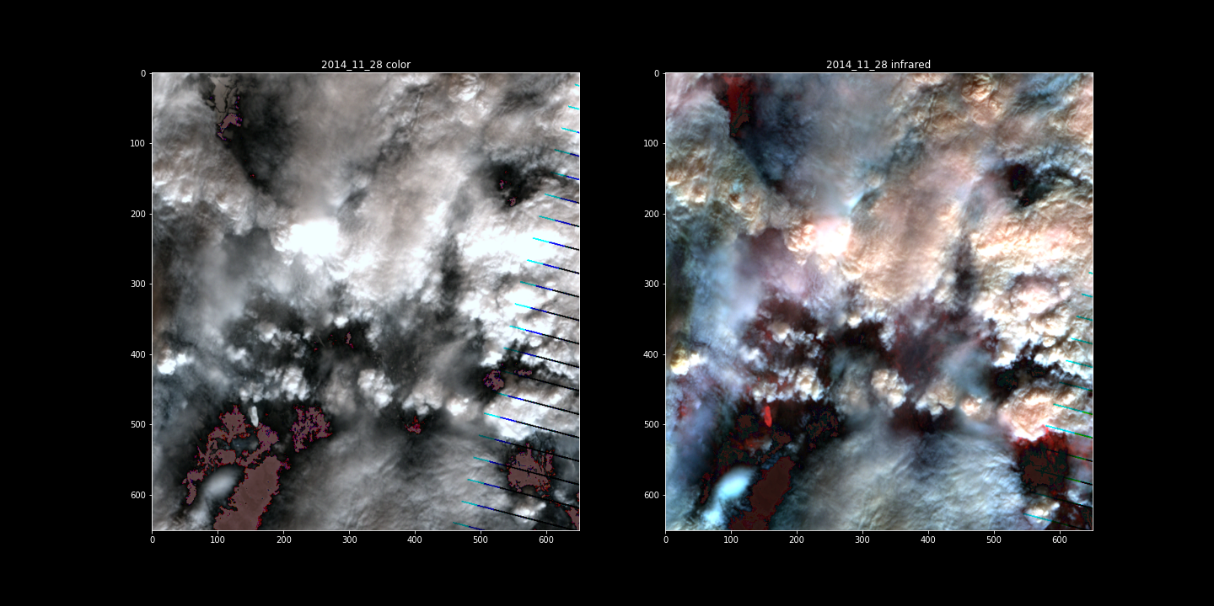
Goal 2
The colored images clearly demonstrate vegetation, lakes/rivers, clouds/shade, a man-made construct like a road can be seen with colored image and highlighted by infrared data.
The infrared data can give a sense of the topography, not exact but there's some depth of hills versus river/bodies of water
November 2014 and 2015 had fries demonstrated from smoke of color and flame map of infrared data
Looking over all images there’s clear indication of change of seasons, especially winter months with frozen lakes/snow

Slide 8
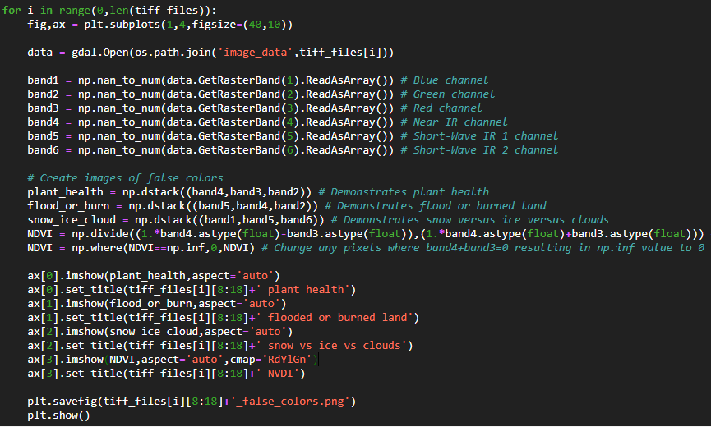
Goal 3
For this goal, use of false color images to identify features that can’t be easily explained
Band 4, Band 3, Band 2 demonstrates changes in plant health
Band 5, Band 4, Band 2 demonstrates flood/newly burned land
Band 1, Band 5, Band 6 demonstrates differences in snow, ice, and clouds
Normalized Difference Vegetation Index (NDVI) can be calculated to see vegetation versus
NDVI = (Band 4 – Band 3) / (Band 4 + Band 3).

Slide 9
Goal 3
Most imagery seemed to highlight other observations such as changing of seasons and the two November Fires with the burned lands over the following year
Infrared images demonstrated a highlight in an area previously clear
Plant Health demonstrated a decline in vegetation around the highlighted area
By 2016, RGB image demonstrated the same area as not vegetation
This area might provide insight the source of ecosystem change
Additional information is necessary to determine this and if its human-caused or not

Slide 10
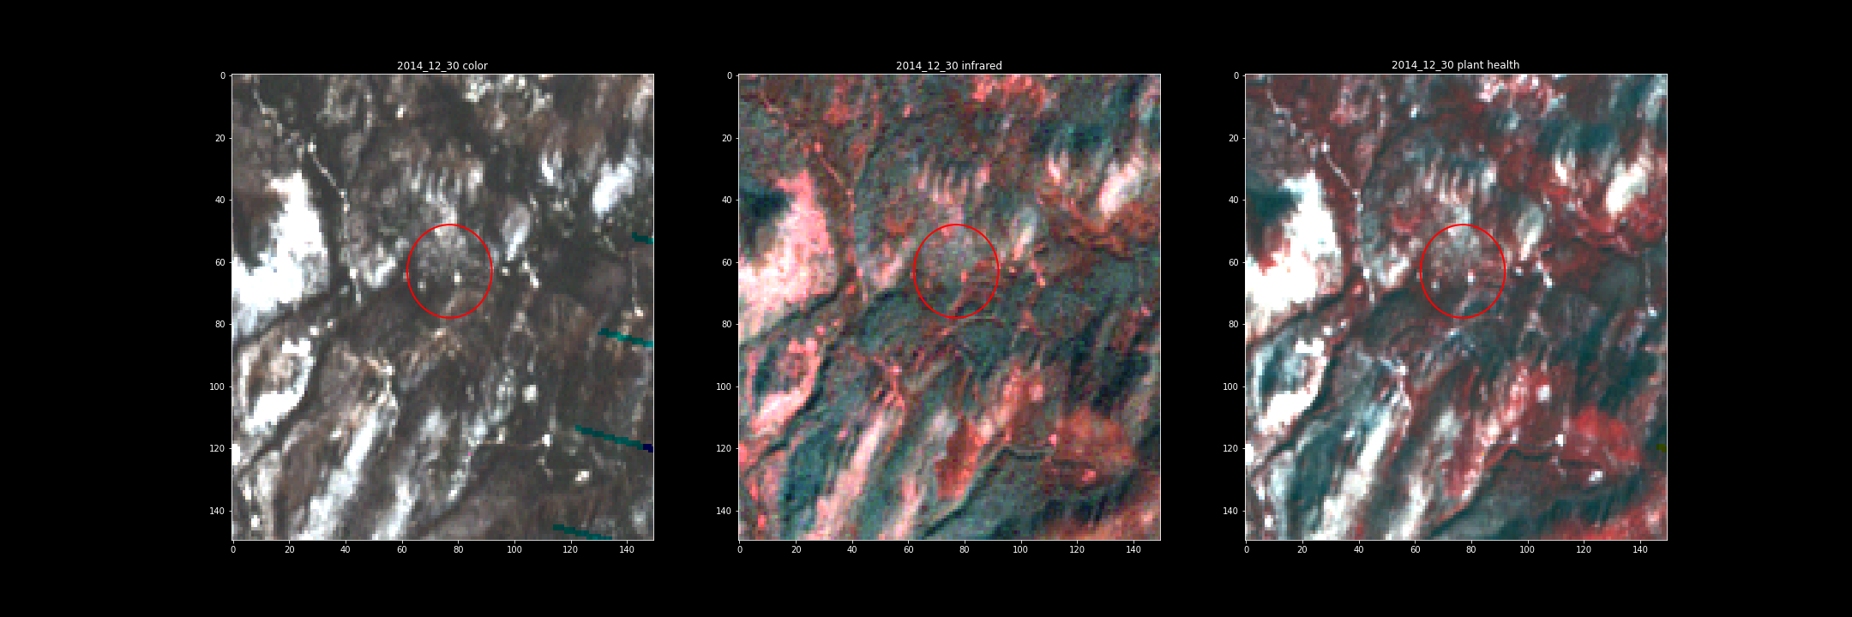
Goal 3 – 2014_12_30
Imagery appears to be normal in the area

Slide 11
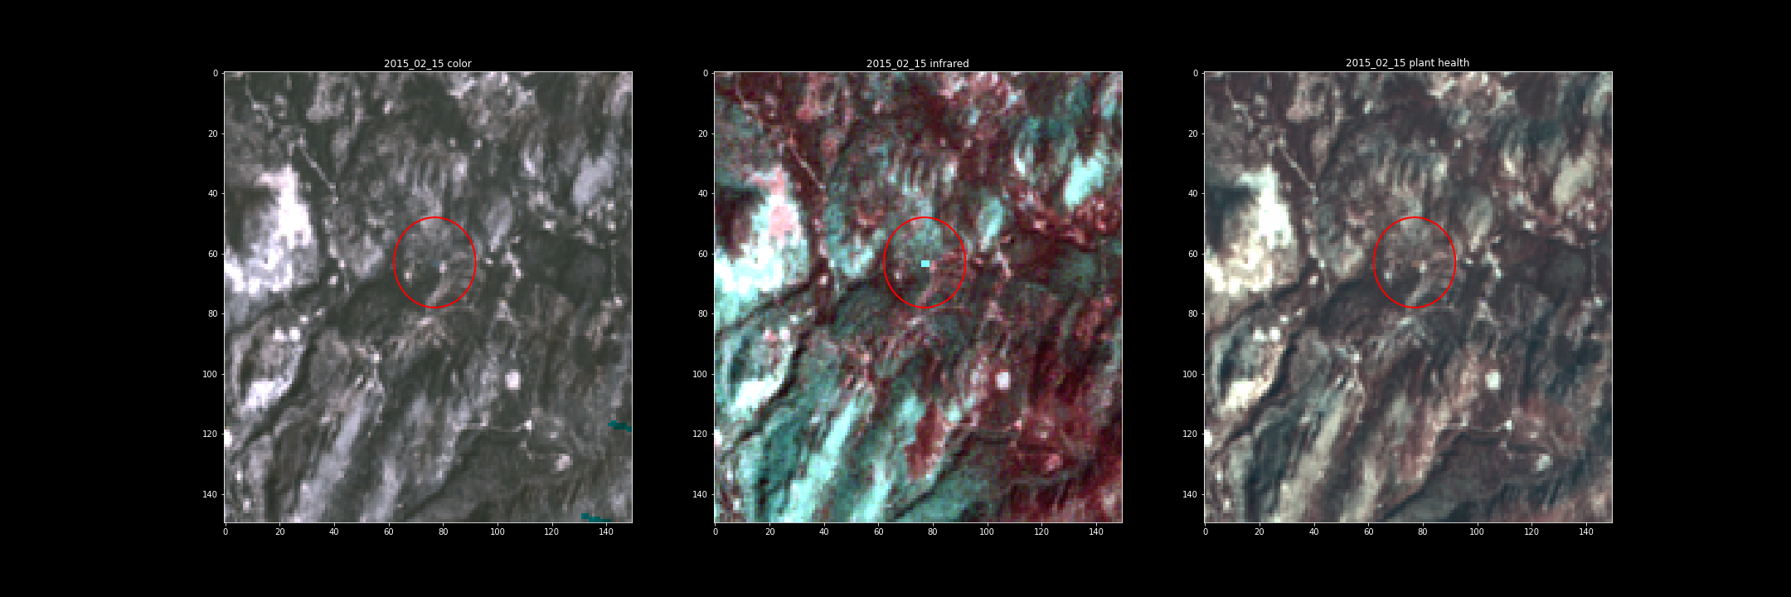
Goal 3 – 2015_02_15
Substance appears on imagery

Slide 12
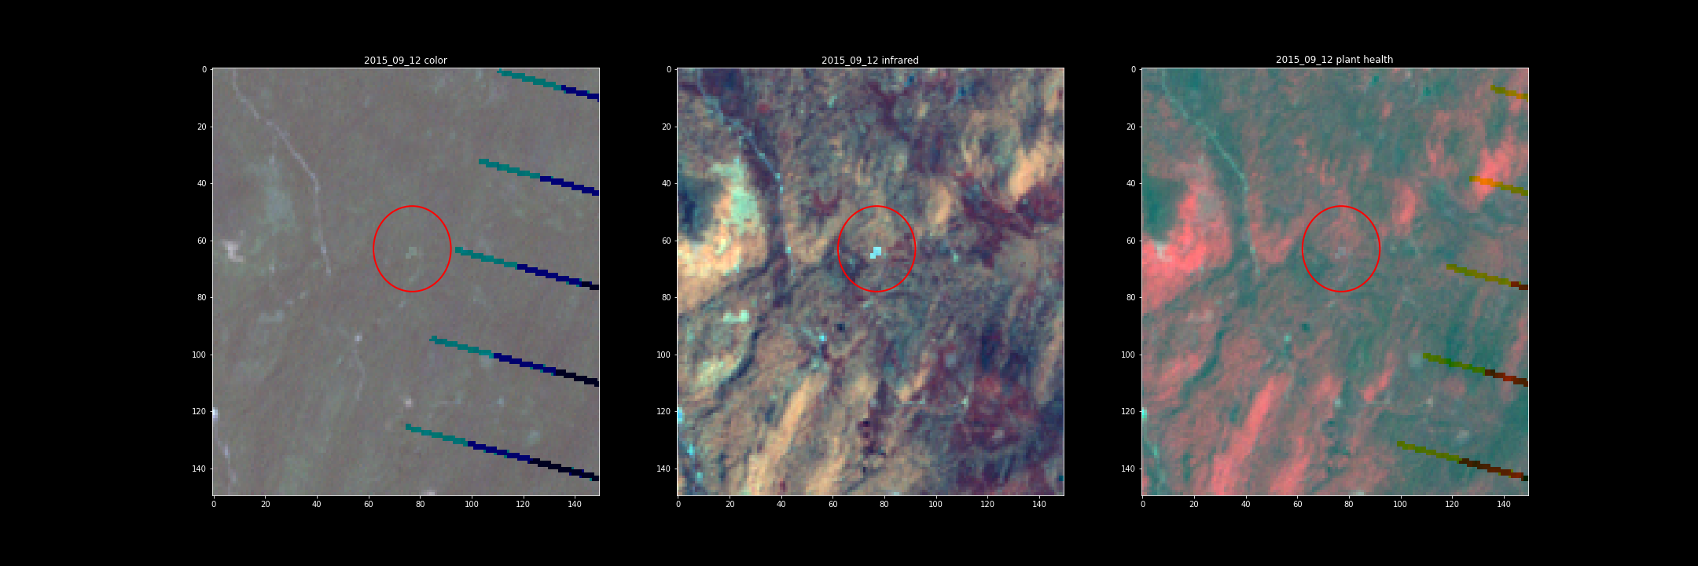
Goal 3 – 2015_09_12
Substance appears to be spreading

Slide 13
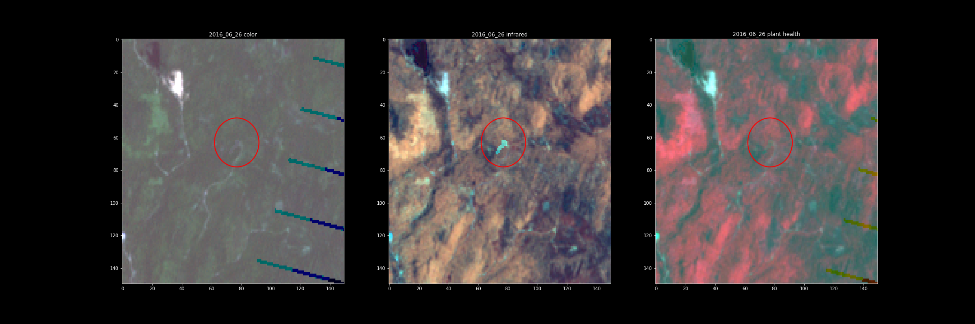
Goal 3 – 2016_06_26
Substance significantly spreading downhill
Plant Health is starting to be negatively affected

Slide 14
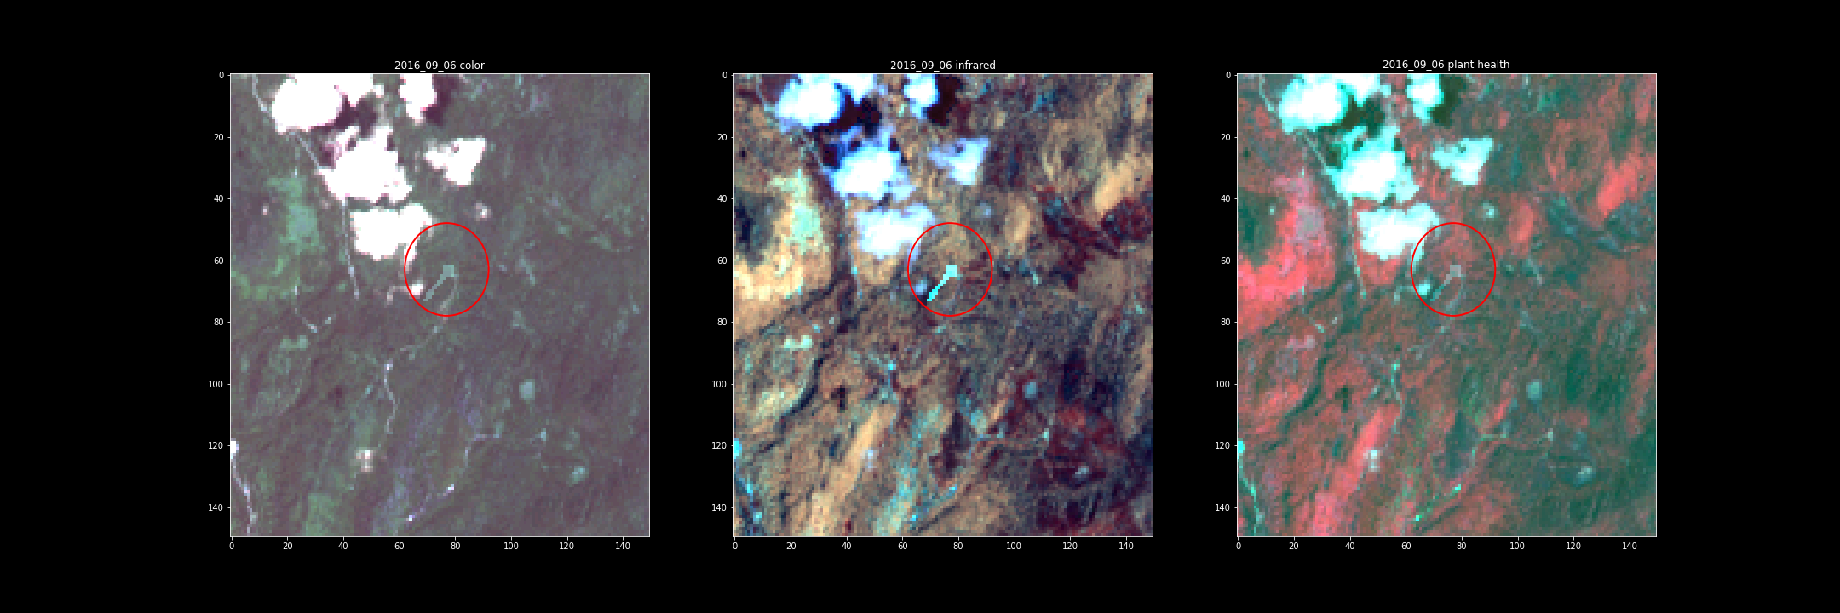
Goal 3 – 2016_09_06
Substance appears on RBG imagery

Slide 15
Goal Conclusions
Goal 1: How much area is covered by a pixel in these images
Found that each pixel covers 10,000 square feet and the satellite imagery has normal cardinal directions
Goal 2: Confidently identify some features from the images
Identified multiple geographical features, such as rivers/lakes, roads, along with fire imagery from November 2014 and 2015
Goal 3: Identify features of the imagery that need additional information
Possible ecological damage was highlighted by infrared and plant health imagery that could answer the decline in Pipet nestings

Slide 16
Questions?

